Slide 1
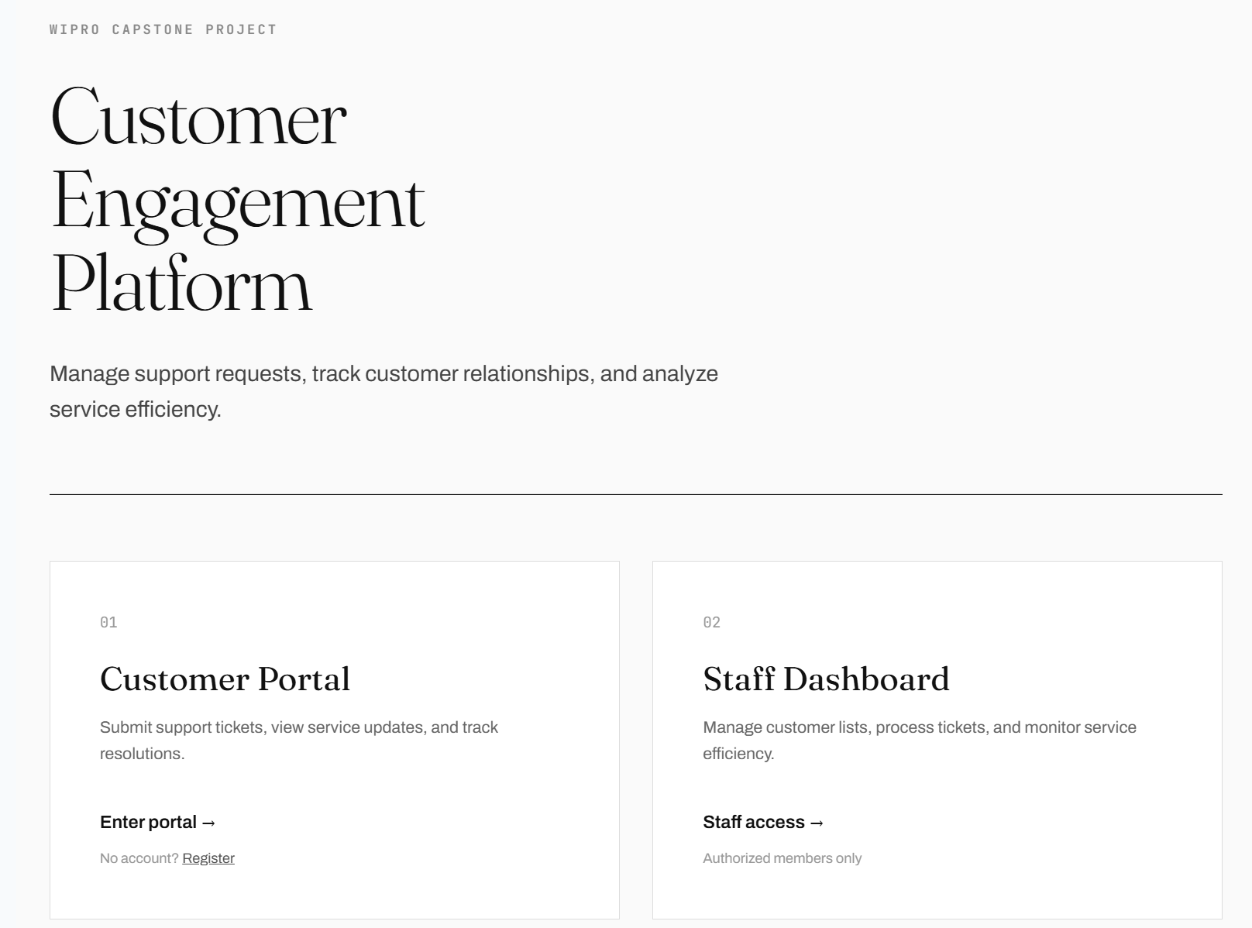
WIPRO CAPSTONE PROJECT
Customer
Engagement
Platform
Submitted By: Saumya Singh
ASP.NET Core MVC | SQL Server | EF Core | JWT | Swagger

Slide 2
OVERVIEW
Business Problem
Organizations need one place to manage customers and service tickets instead of juggling spreadsheets and emails.
Tracking support requests manually leads to missed tickets
No visibility into which tickets are open or resolved
Customer data scattered across multiple tools
No role-based access to separate staff from customers
2

Slide 3
OVERVIEW
Project Objectives
Customer Management
Ticket Management
Store and manage customer profiles with full history
Create, assign, and track service tickets end-to-end
Role Based Access
Service Analytics
Separate portals for customers and staff
Dashboard stats to monitor team performance
Secure APIs
Ticket Lifecycle
JWT-protected REST endpoints with Swagger docs
Enforce status flow: Open, In Progress, Resolved
3

Slide 4
ARCHITECTURE
Technology Stack
Frontend
Backend
Database
Security
Tools
ASP.NET Core MVC
ASP.NET Core 8
SQL Server
ASP.NET Identity
Swagger / OpenAPI
Razor Views
C#
Entity Framework Core
JWT Bearer
Docker
Bootstrap 5
REST APIs
Code-First Migrations
Role-Based Auth
GitHub Actions
jQuery AJAX
Business Layer
Visual Studio
4

Slide 5
ARCHITECTURE
System Architecture
User (Web Browser)
ASP.NET Core MVC Application
Controllers | Views | ViewModels
JWT Authentication
REST API Layer
Customers API | Tickets API | Auth API
Role-Based Authorization
Service + Repository Layer
Entity Framework Core
SQL Server Database
Customers | Tickets | Identity Tables
5

Slide 6
DATABASE
Database Design
Customer
Ticket
Id (PK)
Id (PK)
Name
Subject
Email
Description
Phone
Status
Address
Priority
CreatedAt
AssignedAgent
CustomerId (FK)
CreatedAt
UpdatedAt
One Customer can have Many Tickets (1:N)
6

Slide 7
DATABASE
ER Diagram
Ticket
Customer
Id (PK)
Id (PK)
Subject
Name
Description
Email
has
Status
1
N
Priority
Phone
AssignedAgent
Address
CustomerId (FK)
CreatedAt
UpdatedAt
CreatedAt
7

Slide 8
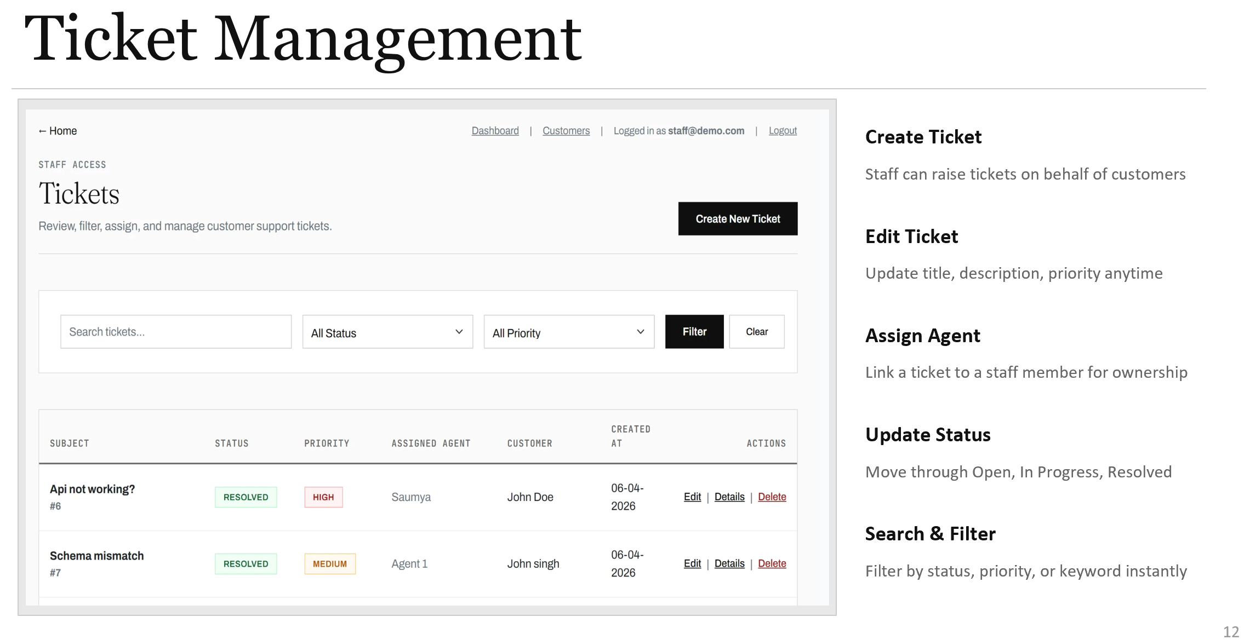
SECURITY
Authentication & Authorization
ASP.NET Identity
- Handles user registration, hashing, and account management
Customer
Staff
Role
Role
JWT Bearer Tokens
- Issued on login, attached to every API request header
Accesses
Accesses
Customer Portal
Staff Dashboard
Customer Role
- Restricted to the Customer Portal only
Staff Role
- Access to Staff Dashboard, Customer Management, and Ticket Management
8

Slide 9
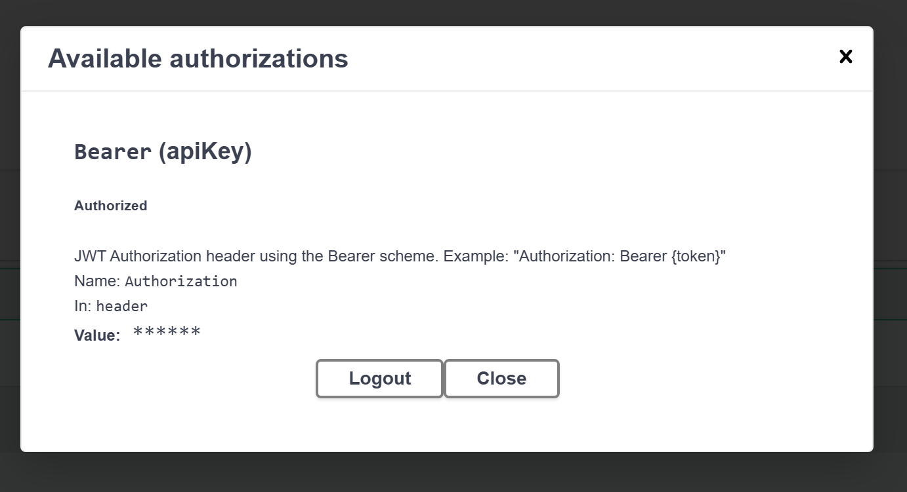
SECURITY
JWT Authentication Flow
01
02
03
04
Login
Generate Token
Authorize Swagger
Access APIs
POST /api/auth/login with credentials
Server validates, issues signed JWT
Paste token into Swagger Authorize
JWT validated on every protected endpoint
9

Slide 10
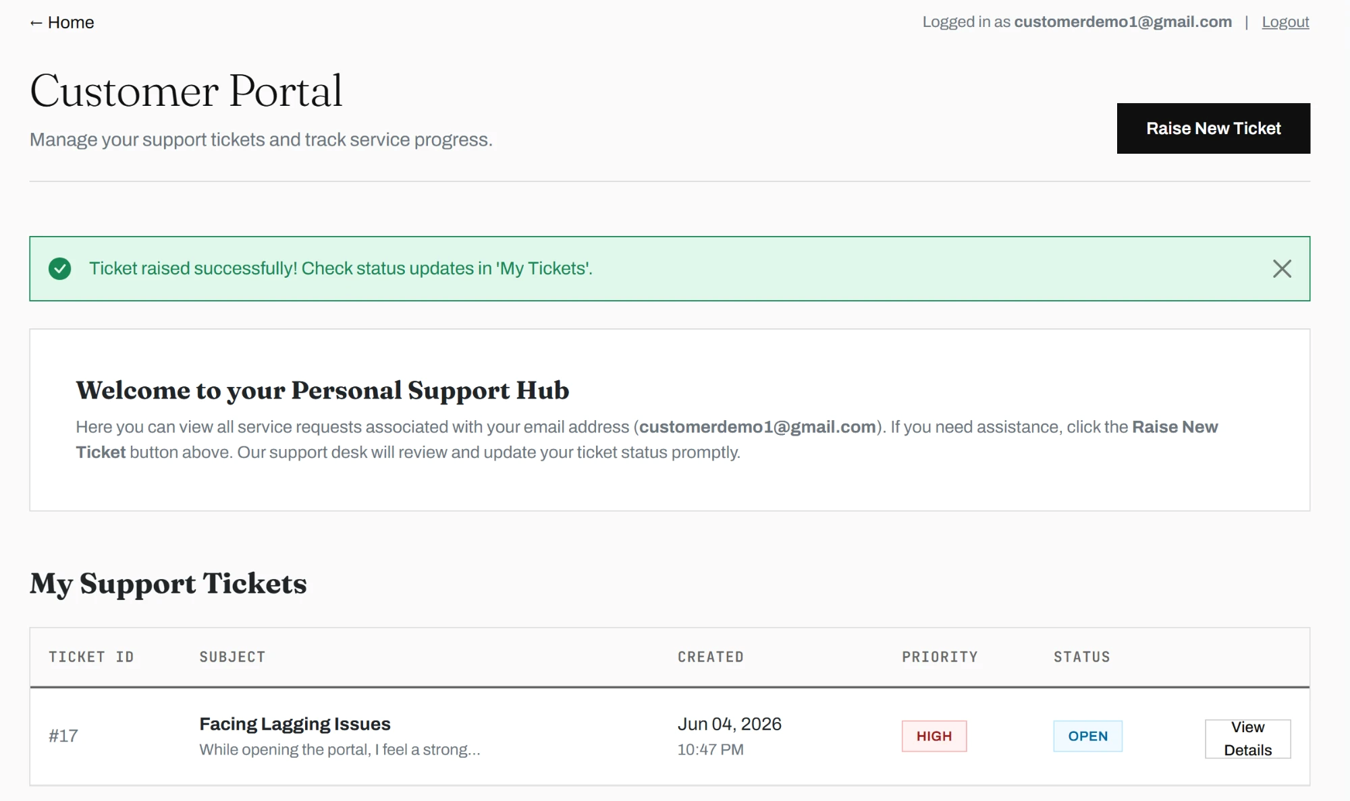
FEATURES
Customer Portal
Raise Ticket
Submit new support requests with subject, description, and priority
Track Status
See real-time status of all submitted tickets
Ticket Details
View full thread and history for each ticket
Ticket History
All past tickets visible in one list
10

Slide 11
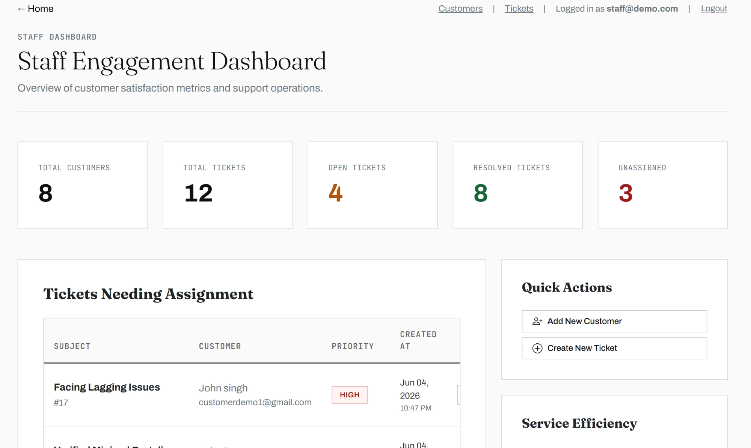
FEATURES
Staff Dashboard
Total Customers
All registered customers in the system
Total Tickets
Combined count of all service requests
Open Tickets
Tickets still waiting for resolution
Resolved Tickets
Successfully closed tickets
Unassigned
Tickets not yet assigned to any agent
11

Slide 12
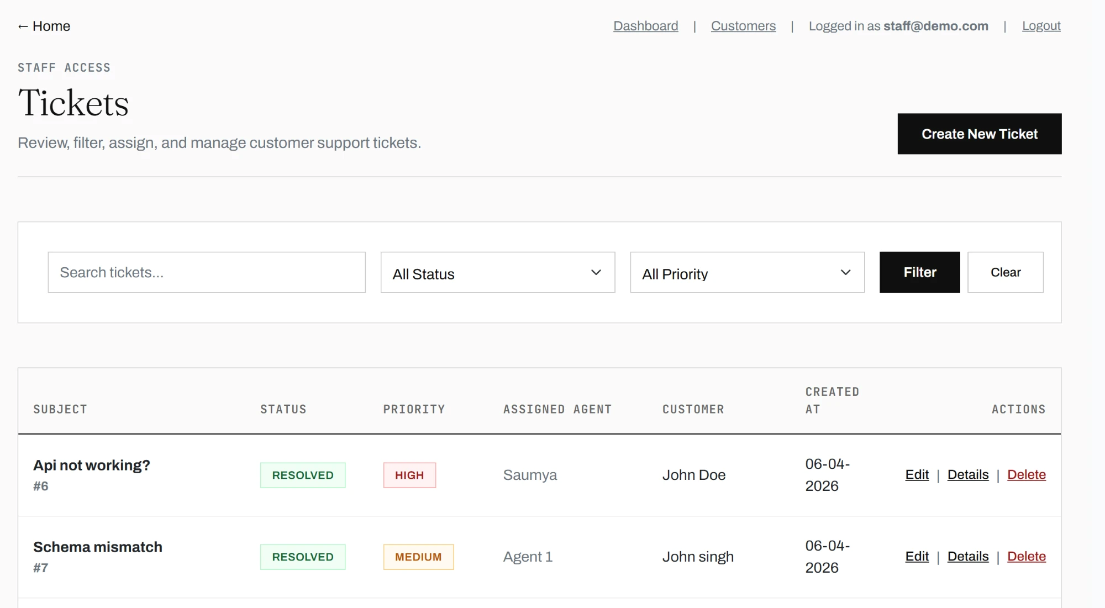
FEATURES
Ticket Management
Create Ticket
Staff can raise tickets on behalf of customers
Edit Ticket
Update subject, description, priority, assigned agent,
and status
Assign Agent
Link a ticket to a staff member for ownership
Update Status
Move through Open, In Progress, Resolved
Search & Filter
Filter by status, priority, or keyword instantly
12

Slide 13
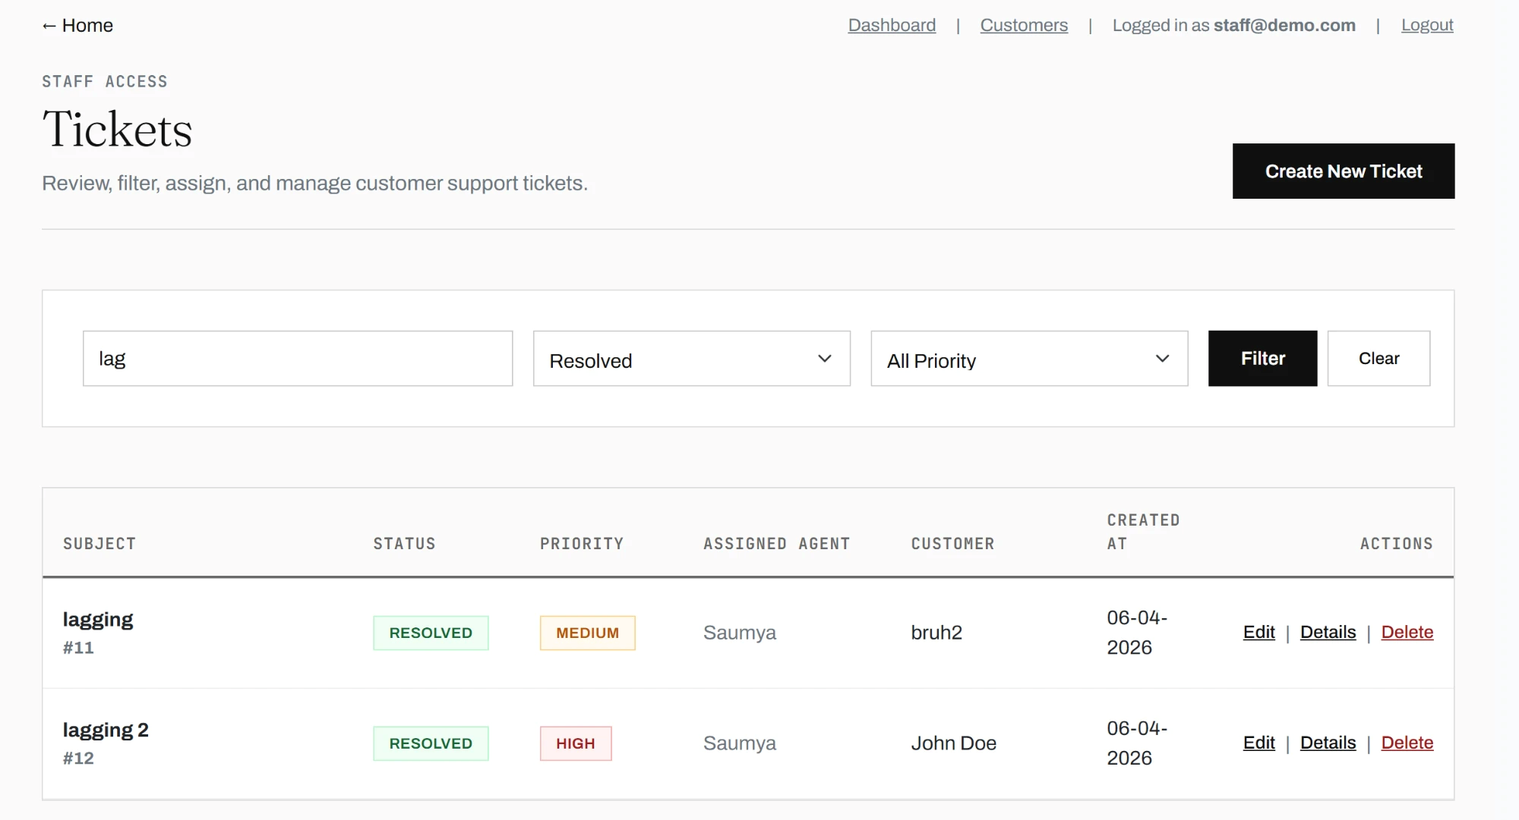
IMPLEMENTATION
AJAX Implementation
Filtering and search happen without a full page reload. The ticket list updates live as the user types or picks a filter.
Search by ticket subject or description
Filter by status: Open / In Progress / Resolved
Filter by priority: Low / Medium / High
No page reload on any filter action
13

Slide 14
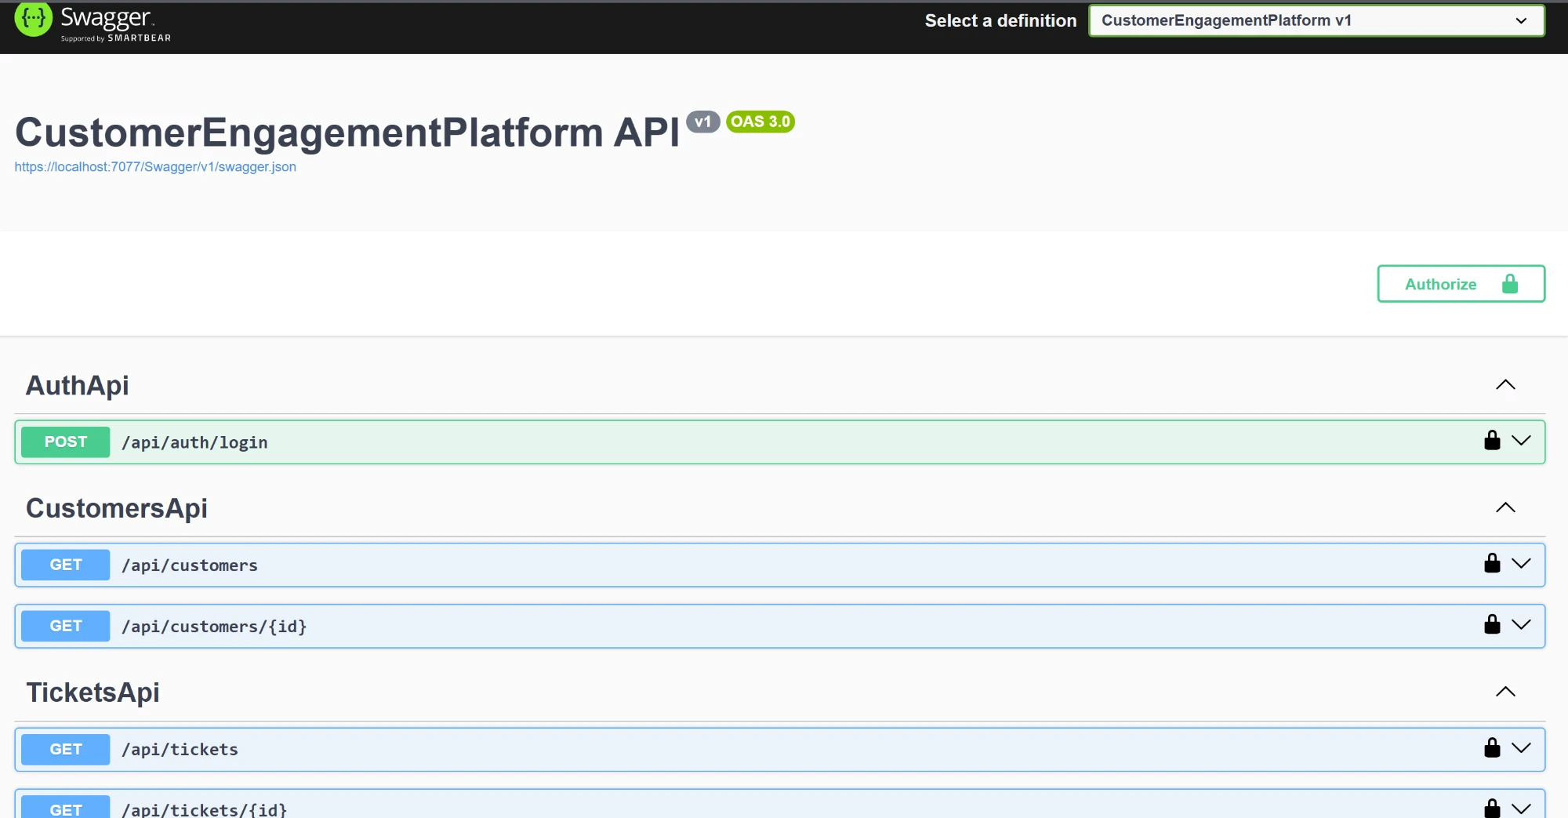
APIS
REST APIs & Swagger
All non-auth endpoints require a valid JWT token in the Authorization header.
Auth API
POST /api/auth/login
Customer API
GET /api/customers
GET /api/customers/{id}
Ticket API
GET /api/tickets
GET /api/tickets/{id}
14

Slide 15
BUSINESS LOGIC
Business Rules
Customers can only access the Customer Portal
Staff Dashboard is blocked for the Customer role
Staff can access the Staff Dashboard, Customer Management, and Ticket Management modules
Customer Portal routes are restricted to Customer role
New tickets start as Unassigned
No agent is auto-assigned on creation
Ticket lifecycle is enforced
Open --> In Progress --> Resolved
Customers and ticket data are maintained through EF Core entity relationships
Prevents orphaned ticket records in the database
15

Slide 16
ARCHITECTURE
Design Patterns & Best Practices
Patterns
SOLID Principles
MVC Pattern
Single Responsibility
Model, View, Controller separation keeps concerns isolated
Each class has one reason to change
Repository Pattern
Dependency Inversion
Data access abstracted behind ITicketRepository interface
Controllers depend on abstractions, not concrete classes
Dependency Injection
Open/Closed Principle
Services and repos registered in Program.cs via DI container
Repository abstraction allows extension without modifying controller logic
16

Slide 17
Approach
Traditional vs Latest Approach
Traditional
Latest
Controllers directly handled database queries
Full page reload after every search or filter
Basic login-based access only
Manual database changes without migration tracking
Less separation between UI, business logic, and data access
Repository Pattern separates data access from controllers
AJAX filtering updates ticket list without full page reload
JWT-secured REST APIs support future integration
EF Core migrations track database schema changes
MVC, Service, Repository, and Database layers keep code organized
Top 10 most Important Modules
Customer Management | Ticket Management | Customer Portal | Staff Dashboard | Authentication | JWT APIs | AJAX Filtering | Repository Layer | EF Core Database | Testing

Slide 18
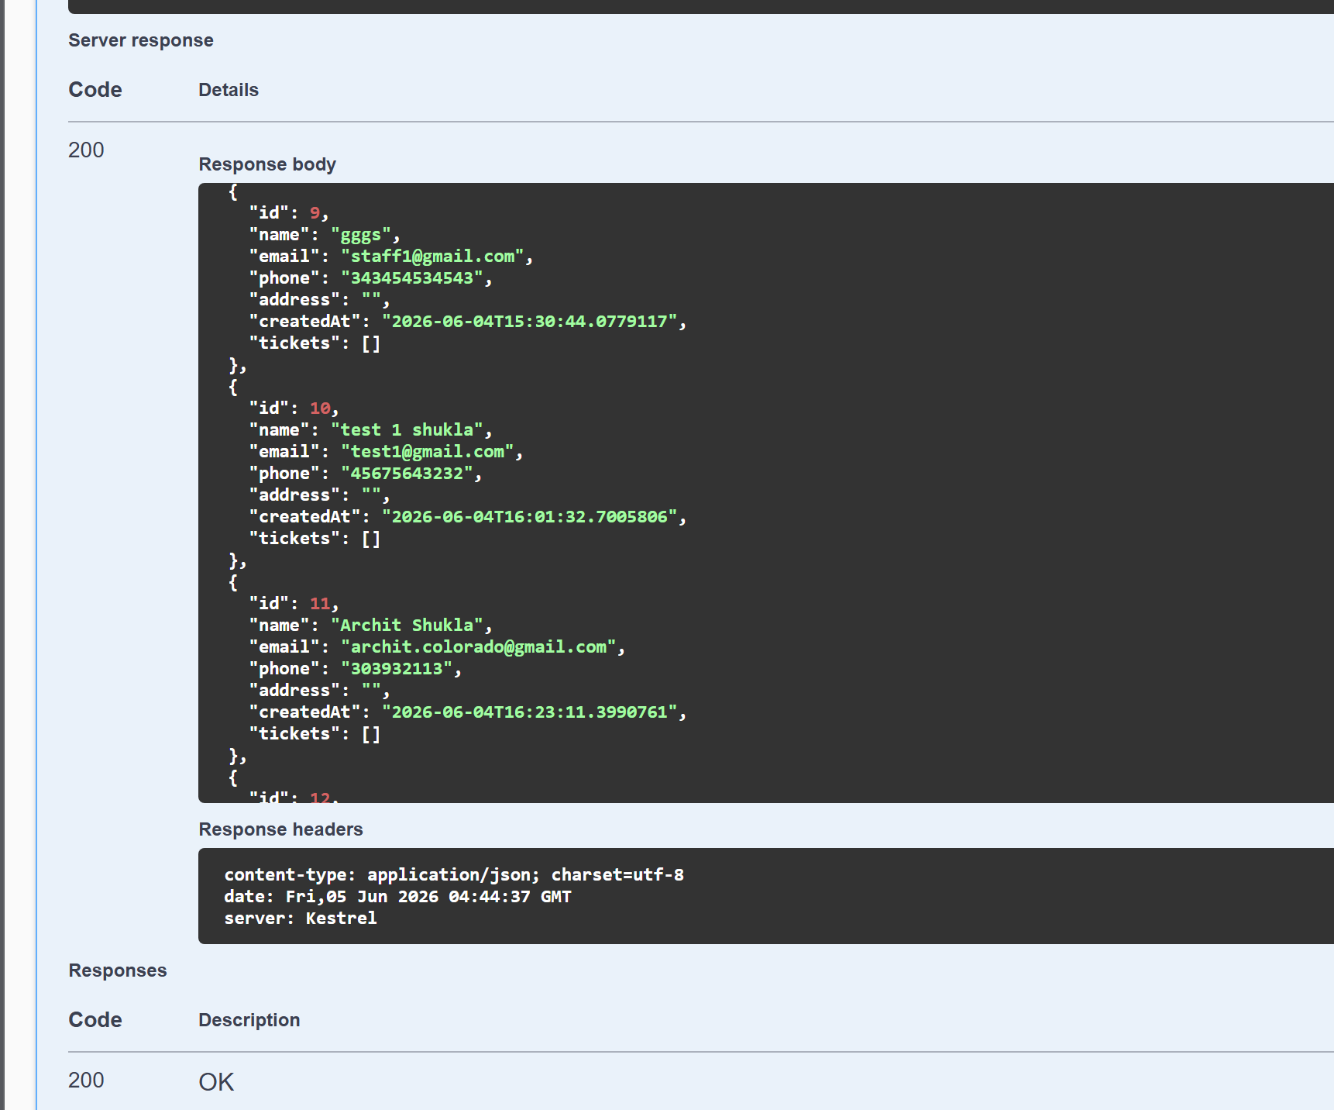
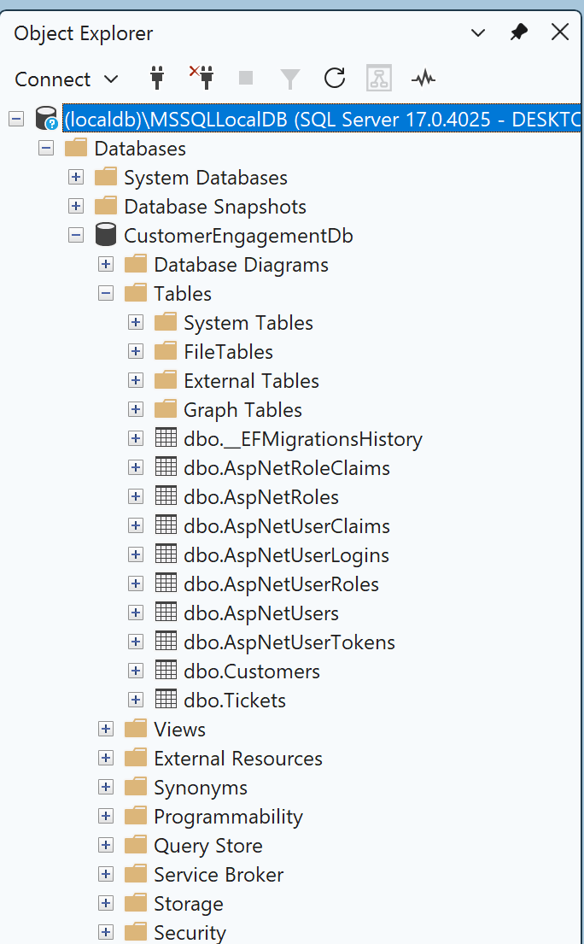
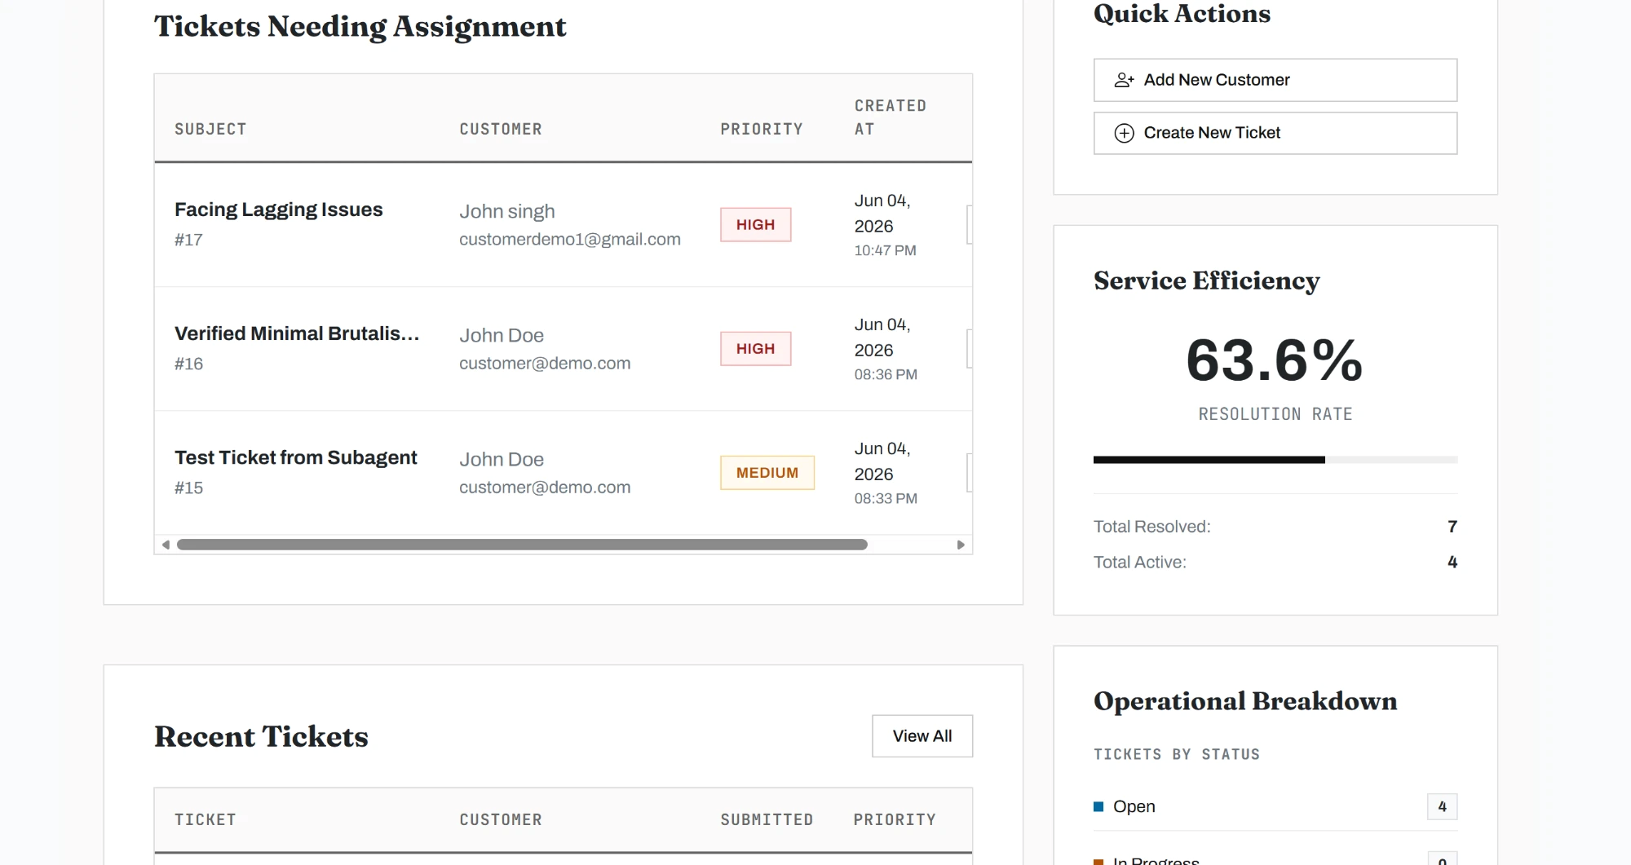
TESTING
Testing & Validation
API response: 200 OK
SQL Server: all tables created
Dashboard: live data
Unit tests were executed using dotnet test
Role testing: verified Customer and Staff route restrictions
JWT testing: verified token generation, Swagger Authorization, and protected API access
Full CRUD validation across Customer and Ticket modules
API validation tested via Swagger with valid and invalid payloads
17

Slide 19
WIPRO CAPSTONE PROJECT
Conclusion & Future Scope
What's Built
What's Next
Customer management with full CRUD
Ticket lifecycle management
Analytics dashboard for staff
JWT-secured REST API layer
Swagger-documented endpoints
AJAX-powered filtering
Email notifications on ticket updates
AI-based ticket summarization
Agent workload balancing
Cloud deployment (Azure / AWS)
Advanced analytics and reporting
Saumya Singh | Wipro Capstone 2026

